Slide 1
Data Analysis and Visualisation with Python Pandas
John Benedict S. Ty

Slide 2

Download the data
Download the github dataset from:
https://github.com/jsty-pcu/python-pandas
Unzip the folder, and save the data file in a location you’ll remember.

Slide 3
How to download
You can use the git command from your local computer to clone the project.
git clone https://github.com/jsty-pcu/python-pandas
Alternatively, you can download the project in ZIP file to try it yourself

Slide 4
Startup
Install Python (version 3.9 or above)
Create a virtual environment in order not to mixed up with the global environment
python –m venv [name_of_virtual_environment]
Activate the virtual environment
Linux:
[location_of_virtual_environment]\bin\activate
Windows:
[location_of_virtual_environment]\Scripts\activate

Slide 5
Startup (cont)
Download all the requirements in the project, In the project folder run the following command.
pip install –r requirements.txt
Run the project.
Linux:
python3 [file_name].py
Windows:
python [file_name].py

Slide 6
Pandas
Pandas, like NumPy, is one of the most popular Python libraries for data analysis.
It is a high-level abstraction over low-level NumPy, which is written in pure C.
Pandas provides high-performance, easy-to-use data structures and data analysis tools.
There are two main structures used by pandas; data frames and series.

Slide 7


Indices in a pandas series
A pandas series is similar to a list, but differs in the fact that a series associates a label with each element. This makes it look like a dictionary.
If an index is not explicitly provided by the user, pandas creates a RangeIndex ranging from 0 to N-1.
Each series object also has a data type.
In:
Out:

Slide 8




As you may suspect by this point, a series has ways to extract all of the values in the series, as well as individual elements by index.
In:
Out:
You can also provide an index manually.
In:
Out:

Slide 9
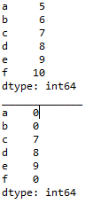

It is easy to retrieve several elements of a series by their indices or make group assignments.
Out:
In:

Slide 10
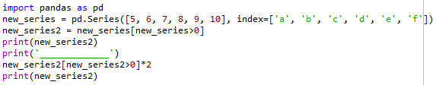
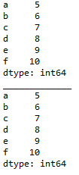
Filtering and maths operations
Filtering and maths operations are easy with Pandas as well.
In:
Out:

Slide 11
Pandas data frame
Simplistically, a data frame is a table, with rows and columns.
Each column in a data frame is a series object.
Rows consist of elements inside series.
Case ID | Variable one | Variable two | Variable three
1 | 123 | ABC | 10
2 | 456 | DEF | 20
3 | 789 | XYZ | 30

Slide 12
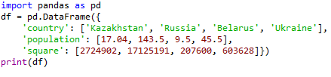

Creating a Pandas data frame
Pandas data frames can be constructed using Python dictionaries.
In:
Out:

Slide 13

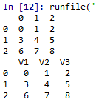
You can also create a data frame from a list.
In:
Out:

Slide 14
You can ascertain the type of a column with the type() function.
In:
Out:

Slide 15
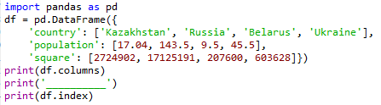

A Pandas data frame object as two indices; a column index and row index.
Again, if you do not provide one, Pandas will create a RangeIndex from 0 to N-1.
In:
Out:

Slide 16
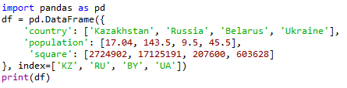

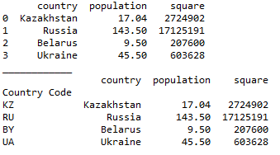
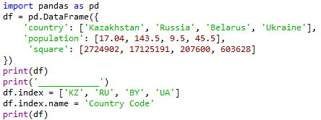
There are numerous ways to provide row indices explicitly.
For example, you could provide an index when creating a data frame:
In:
Out:
or do it during runtime.
Here, I also named the index ‘country code’.
Out:
In:

Slide 17

Row access using index can be performed in several ways.
First, you could use .loc() and provide an index label.
In:
Out:
Second, you could use .iloc() and provide an index number
Out:
In:

Slide 18


A selection of particular rows and columns can be selected this way.
In:
Out:
You can feed .loc() two arguments, index list and column list, slicing operation is supported as well:
In:
Out:

Slide 19

Filtering
Filtering is performed using so-called Boolean arrays.

Slide 20



Deleting columns
You can delete a column using the drop() function.
In:
Out:
In:
Out:

Slide 21
Reading from and writing to a file
Pandas supports many popular file formats including CSV, XML, HTML, Excel, SQL, JSON, etc.
Out of all of these, CSV is the file format that you will work with the most.
You can read in the data from a CSV file using the read_csv() function.
Similarly, you can write a data frame to a csv file with the to_csv() function.

Slide 22
Exploratory data analysis (EDA)
Exploring your data is a crucial step in data analysis. It involves:
Organising the data set
Plotting aspects of the data set
Maybe producing some numerical summaries; central tendency and spread, etc.

Slide 23
Reading in the data
First we import the Python packages we are going to use.
Then we use Pandas to load in the dataset as a data frame.
NOTE: The argument index_col argument states that we'll treat the first column of the dataset as the ID column.
NOTE: The encoding argument allows us to by pass an input error created by special characters in the data set.

Slide 24
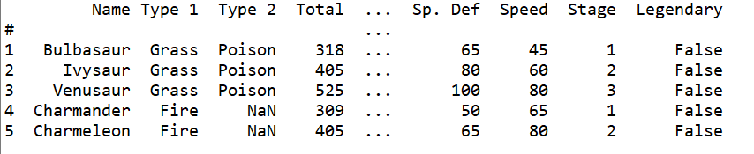
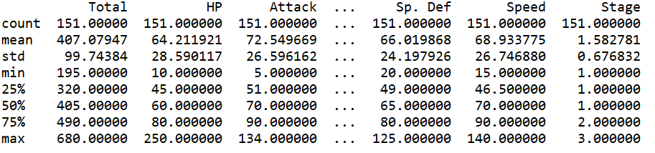
Examine the data set

Slide 25
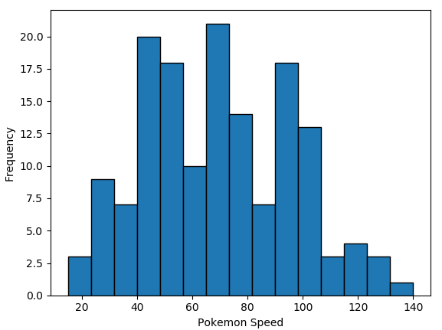
We could spend time staring at these numbers, but that is unlikely to offer us any form of insight.
We could begin by conducting all of our statistical tests.
However, a good field commander never goes into battle without first doing a recognisance of the terrain…
This is exactly what EDA is for…

Slide 26
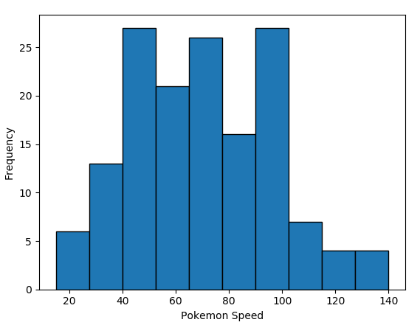

Plotting a histogram in Python

Slide 27
Bins
You may have noticed the two histograms we’ve seen so far look different, despite using the exact same data.
This is because they have different bin values.
The left graph used the default bins generated by plt.hist(), while the one on the right used bins that I specified.

Slide 28

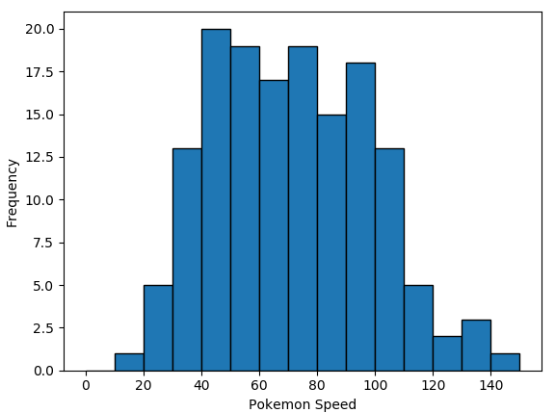
There are a couple of ways to manipulate bins in matplotlib.
Here, I specified where the edges of the bars of the histogram are; the bin edges.

Slide 29

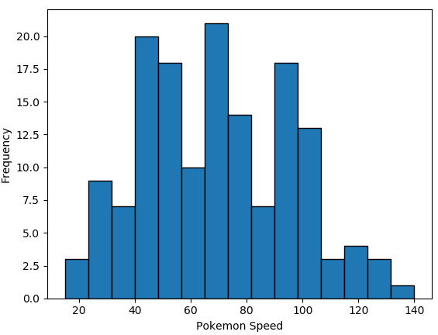
You could also specify the number of bins, and Matplotlib will automatically generate a number of evenly spaced bins.

Slide 30
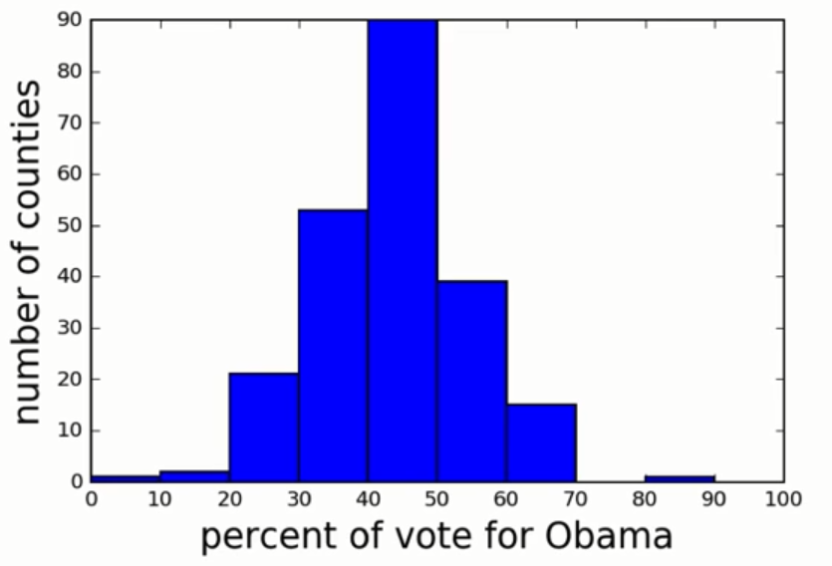
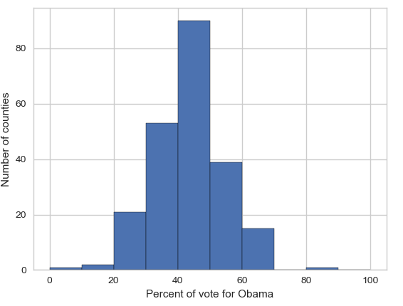
Seaborn
Matplotlib is a powerful, but sometimes unwieldy, Python library.
Seaborn provides a high-level interface to Matplotlib and makes it easier to produce graphs like the one on the right.
Some IDEs incorporate elements of this “under the hood” nowadays.

Slide 31
Benefits of Seaborn
Seaborn offers:
- Using default themes that are aesthetically pleasing.
- Setting custom colour palettes.
- Making attractive statistical plots.
- Easily and flexibly displaying distributions.
- Visualising information from matrices and DataFrames.
The last three points have led to Seaborn becoming the exploratory data analysis tool of choice for many Python users.

Slide 32
Plotting with Seaborn
One of Seaborn's greatest strengths is its diversity of plotting functions.
Most plots can be created with one line of code.
For example….

Slide 33
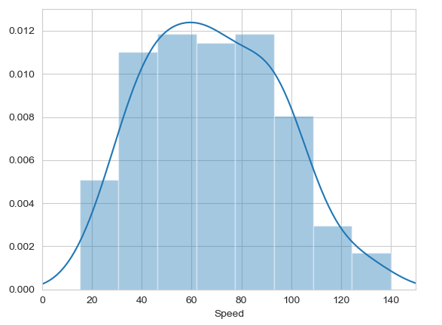

Histograms
Allow you to plot the distributions of numeric variables.

Slide 34
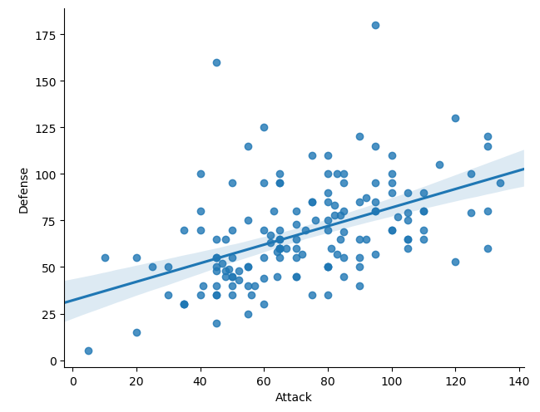
Other types of graphs: Creating a scatter plot
Name of our dataframe fed to the “data=“ command
Name of variable we want on the x-axis
Seaborn “linear model plot” function for creating a scatter graph
Name of variable we want on the y-axis

Slide 35
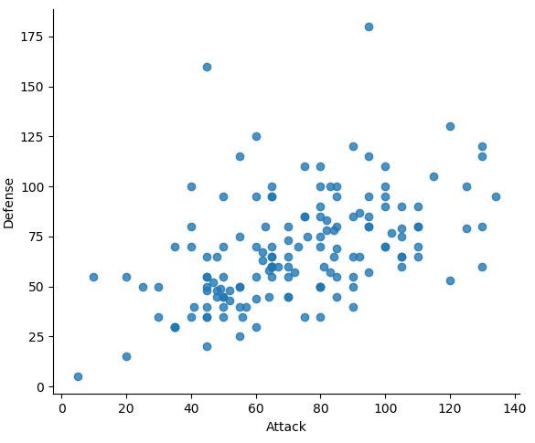
Seaborn doesn't have a dedicated scatter plot function.
We used Seaborn's function for fitting and plotting a regression line; hence lmplot()
However, Seaborn makes it easy to alter plots.
To remove the regression line, we use the fit_reg=False command

Slide 36
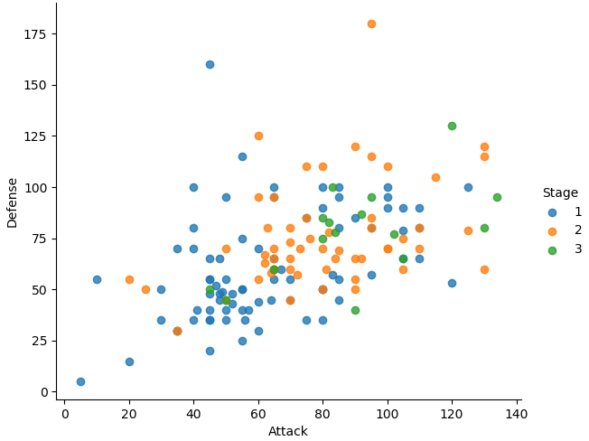

The hue function
Another useful function in Seaborn is the hue function, which enables us to use a variable to colour code our data points.

Slide 37
Violin plots
Violin plots are useful alternatives to box plots.
They show the distribution of a variable through the thickness of the violin.
Here, we visualise the distribution of attack by Pokémon's primary type:

Slide 38
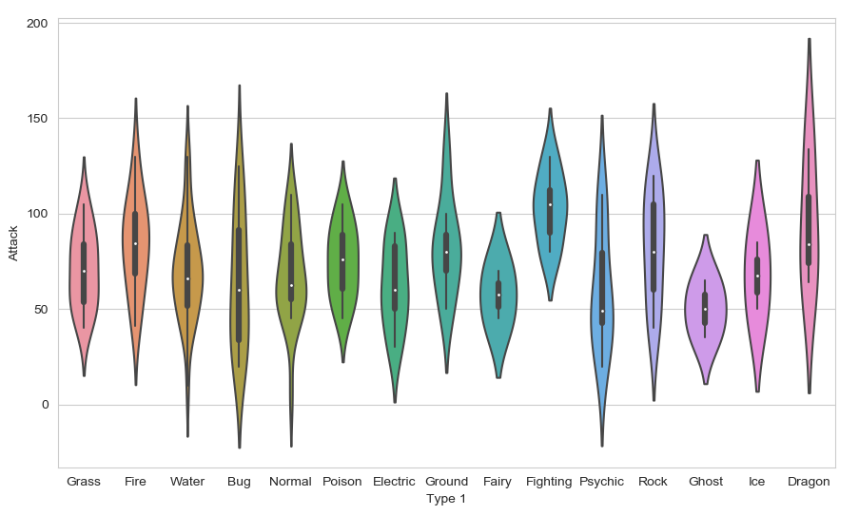
Dragon types tend to have higher Attack stats than Ghost types, but they also have greater variance. But there is something not right here….
The colours!

Slide 39
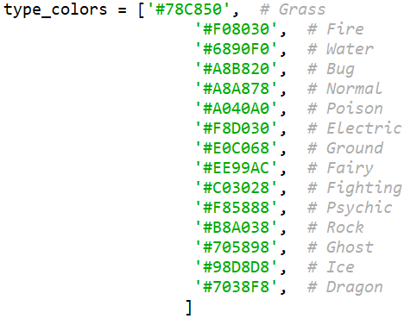
Seaborn’s colour palettes
Seaborn allows us to easily set custom colour palettes by providing it with an ordered list of colour hex values.
We first create our colours list.

Slide 40
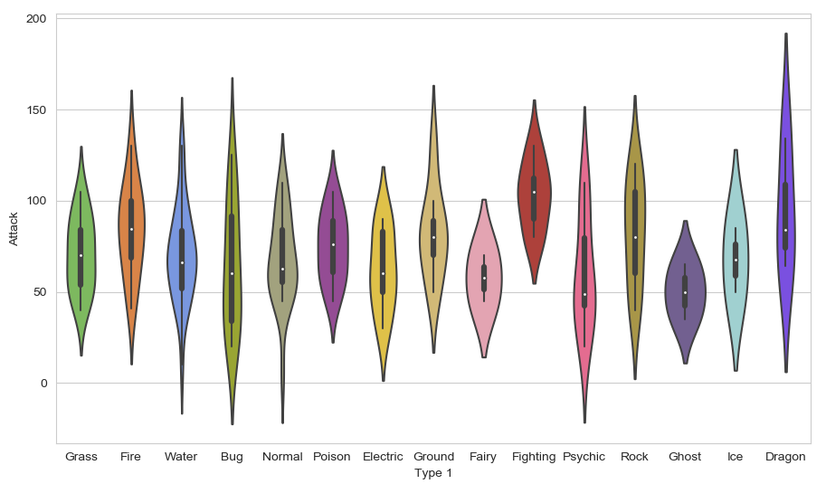
Then we just use the palette= function and feed in our colours list.

Slide 41
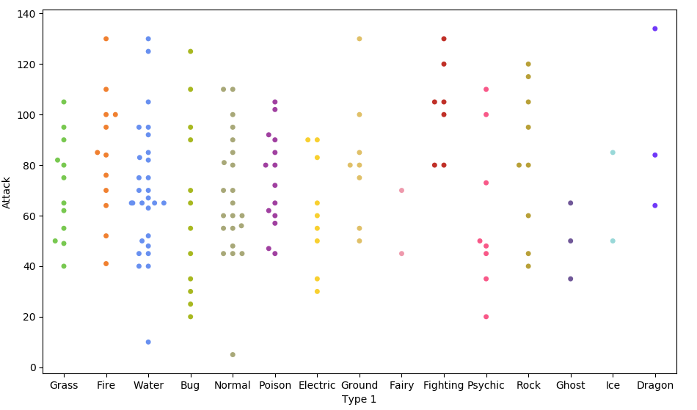

Because of the limited number of observations, we could also use a swarm plot.
Here, each data point is an observation, but data points are grouped together by the variable listed on the x-axis.

Slide 42
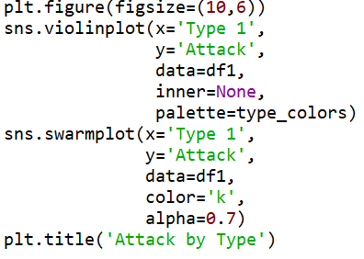
Overlapping plots
Both of these show similar information, so it might be useful to overlap them.
Set size of print canvas.
Remove bars from inside the violins
Make bars black and slightly transparent
Give the graph a title

Slide 43
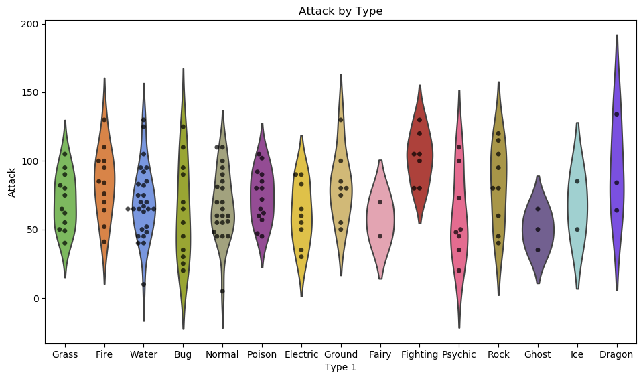

Slide 44
Data wrangling with Pandas
What if we wanted to create such a plot that included all of the other stats as well?
In our current dataframe, all of the variables are in different columns:

Slide 45
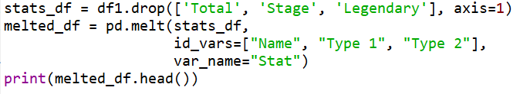
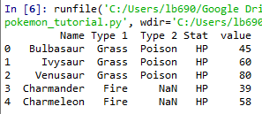


If we want to visualise all stats, then we’ll have to “melt” the dataframe.
We use the .drop() function again to re-create the dataframe without these three variables.
The dataframe we want to melt.
The variables to keep, all others will be melted.
A name for the new, melted, variable.
All 6 of the stat columns have been "melted" into one, and the new Stat column indicates the original stat (HP, Attack, Defense, Sp. Attack, Sp. Defense, or Speed).
It's hard to see here, but each pokemon now has 6 rows of data; hende the melted_df has 6 times more rows of data.

Slide 46
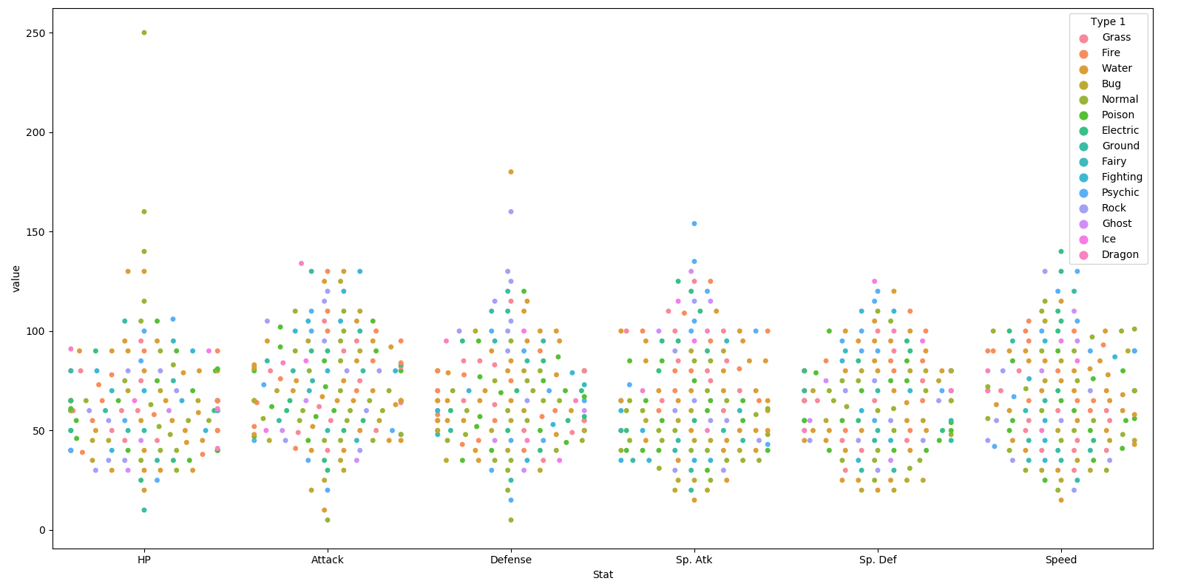

Slide 47
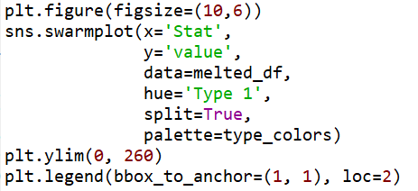
This graph could be made to look nicer with a few tweaks.
Enlarge the plot.
Separate points by hue.
Use our special Pokemon colour palette.
Adjust the y-axis.
Move the legend box outside of the graph and place to the right of it..

Slide 48
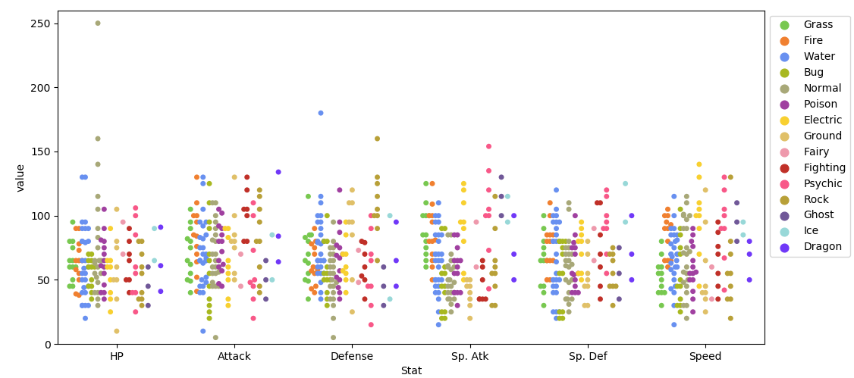

Slide 49
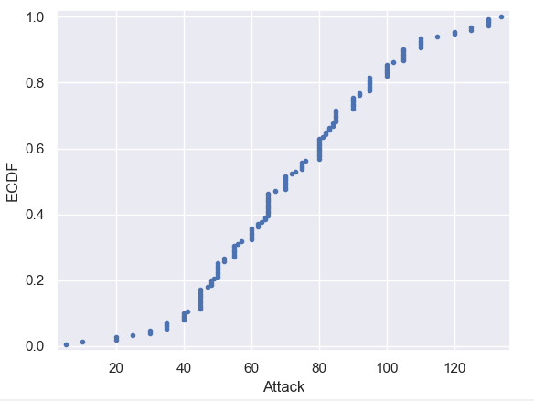
Plotting all data: Empirical cumulative distribution functions (ECDFs)
An alternative way of visualising a distribution of a variable in a large dataset is to use an ECDF.
Here we have an ECDF that shows the percentages of different attack strengths of pokemon.
An x-value of an ECDF is the quantity you are measuring; i.e. attacks strength.
The y-value is the fraction of data points that have a value smaller than the corresponding x-value. For example…

Slide 50
75% of Pokemon have an attack level of 90 or less
20% of Pokemon have an attack level of 50 or less.

Slide 51
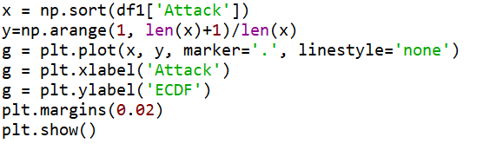
Plotting an ECDF
Notes:
The y-axis is evenly spaced data points with a maximum of 1.

Slide 52
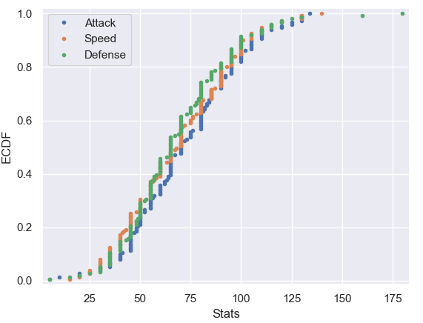
You can also plot multiple ECDFs on the same plot.
As an example, here with have an ECDF for Pokemon attack, speed, and defence levels.
We can see here that defence levels tend to be a little less than the other two.

Slide 53
The usefulness of ECDFs
It is often quite useful to plot the ECDF first as part of your workflow.
It shows all the data and gives a complete picture as to how the data are distributed.

Slide 54
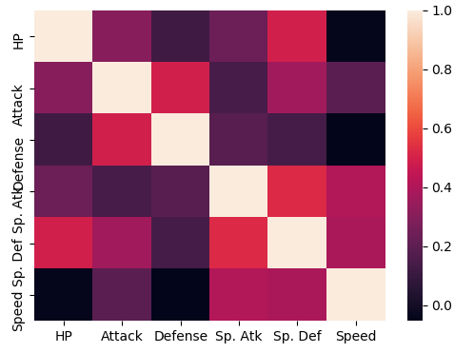

Heatmaps
Useful for visualising matrix-like data.
Here, we’ll plot the correlation of the stats_df variables

Slide 55
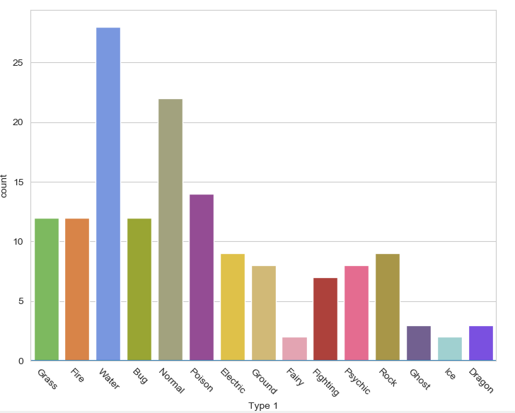

Bar plot
Visualises the distributions of categorical variables.
Rotates the x-ticks 45 degrees

Slide 56
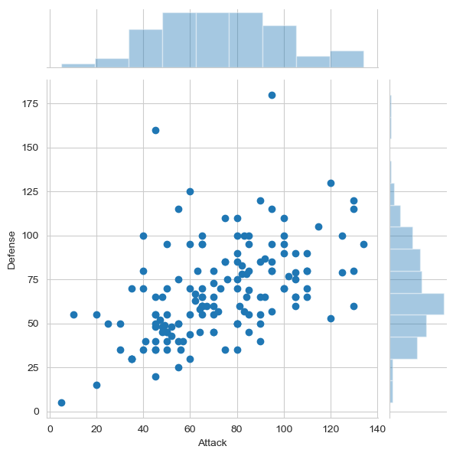

Joint Distribution Plot
Joint distribution plots combine information from scatter plots and histograms to give you detailed information for bi-variate distributions.

